Slide 1
Storm-Based Auto PRF
April 2014
Joe Chrisman
Joe.n.chrisman@noa.gov

Slide 2
Storm-Based Auto PRF Functional Overview
The PRF Selection Function selects the 3¹ most significant storms based on the highest storm-based VIL (Storms must have a VIL > 20 kg/m²)
The “forecast positions” from SCIT are used to project where these storms will be next volume scan
The Auto PRF algorithm:
Calculates a “storm circle” for each storm. The “storm circle” is defined as the boundary of a 20km radius circle around the projected storm location
Calculates the area of “obscured” data within each “storm circle” for each Doppler PRF
Selects the PRF that results in the smallest obscured area within the “storm circles”
Downloads the modified VCP to the RDA which takes affect the NEXT Volume Scan
Each subsequent volume scan, selects the top 3 storms
Recalculates the “storm circles” based on the new projected location for each storm
Repeats these steps until the one of the following conditions are satisfied:
there are no storms identified by the SCIT algorithm², or
the operator selects a different PRF option
Note*¹: The function will track and process up to 3 storms. If there are fewer than 3 storms then use the number of storms available.
Note*²: If no storms meet the VIL threshold, Auto PRF Elevation is used.

Slide 3
Overview – How it Works
Storm-Based Auto PRF
USES
Reflectivity data form the CURRENT volume scan
AND
Storm Cell location and VIL information from the PREVIOUS volume scan
TO
Determine the BEST PRF for the NEXT volume scan

Slide 4
KICT Concern Case
KICT was concerned that during the developing convective event during the evening of Apr 2, Storm-Based Auto PRF was not behaving as expected.
I replayed the Level II data to determined what happened.
The following few slides (four provided with the original question from KICT) explain the behavior of Storm-Based Auto PRF for this event.

Slide 5
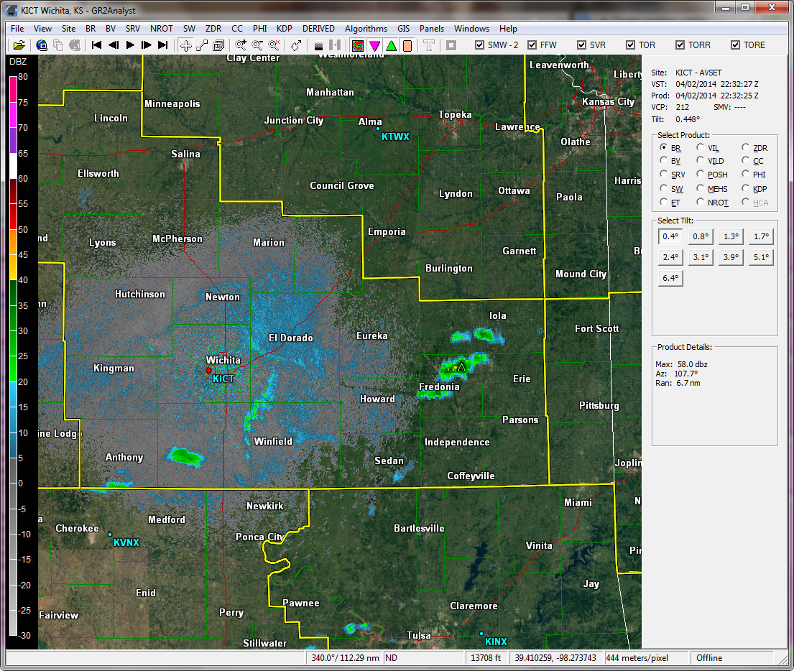
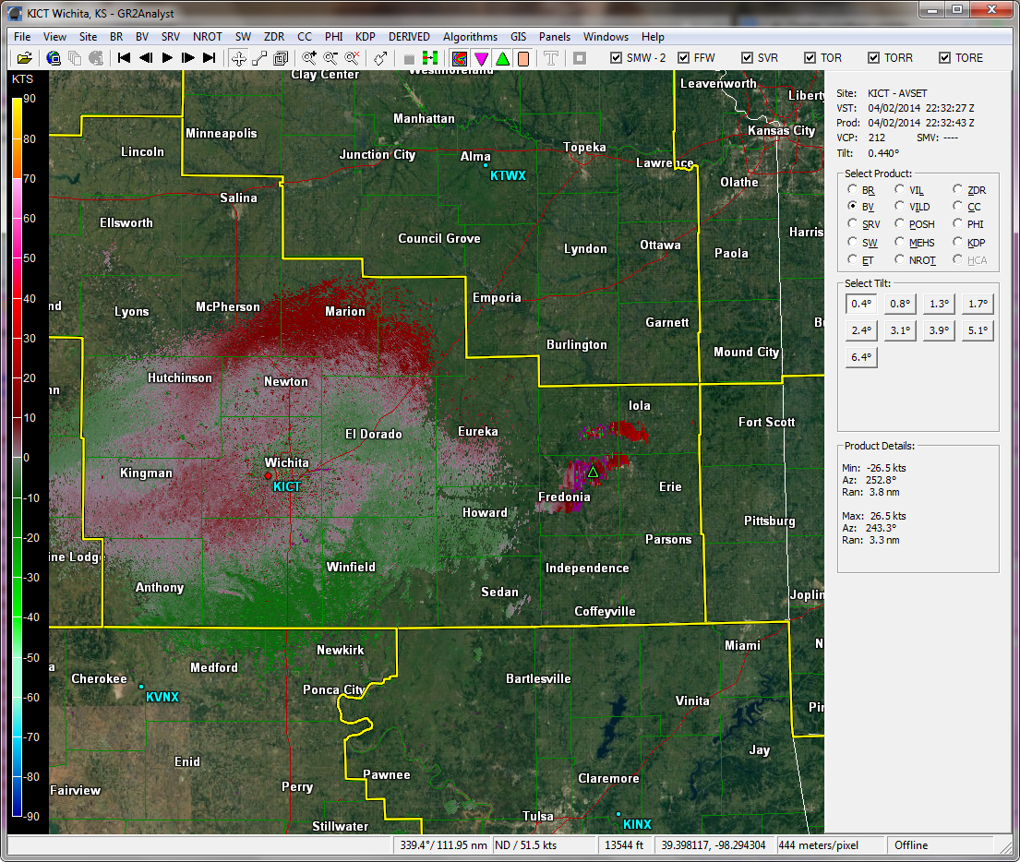
2232Z – Wide Image of what was going on in the area.

Slide 6
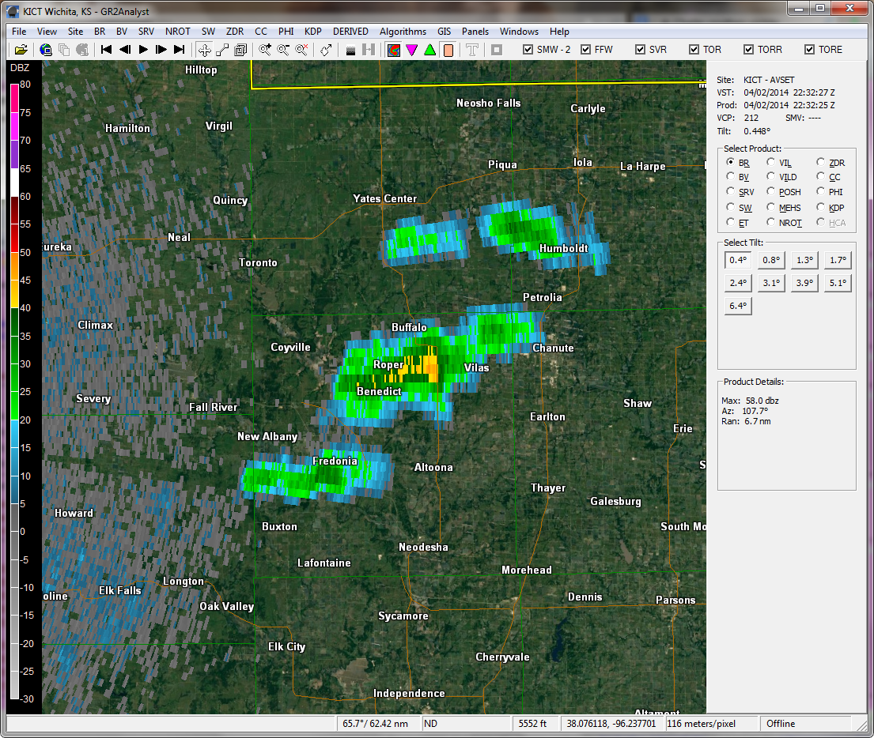
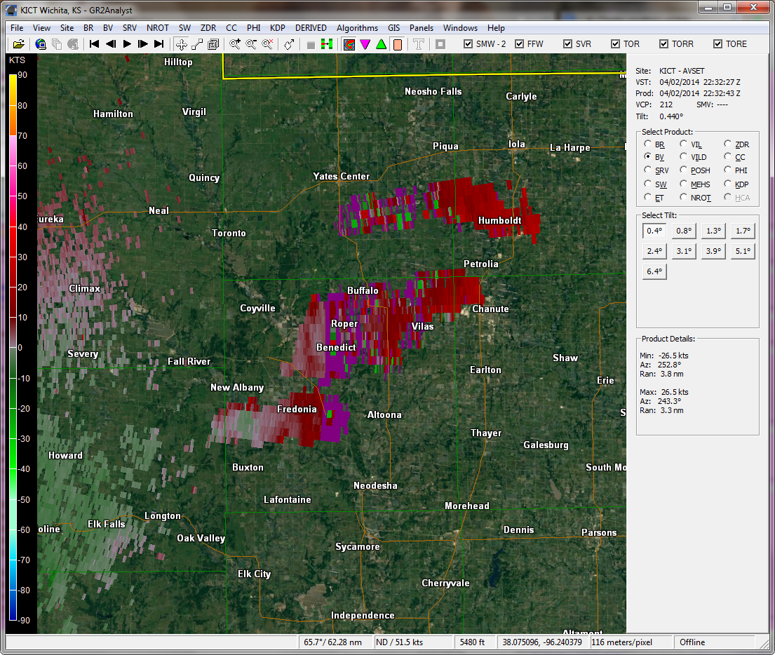
2232Z Image zoomed in

Slide 7
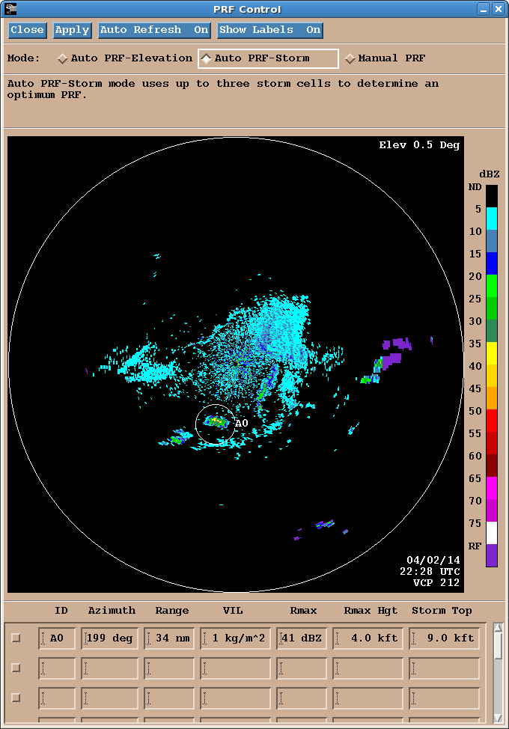
Obvious Question: Why is the ONLY cell on the display range folded?
The PRF for this volume scan was determined LAST volume scan (22:28)
Only Cell was 1 kg/m²
(From 22:22)
Not considered by SBAP
Auto PRF-Elevation (Legacy)
Algorithm used to determine
PRF for this volume scan.

Slide 8
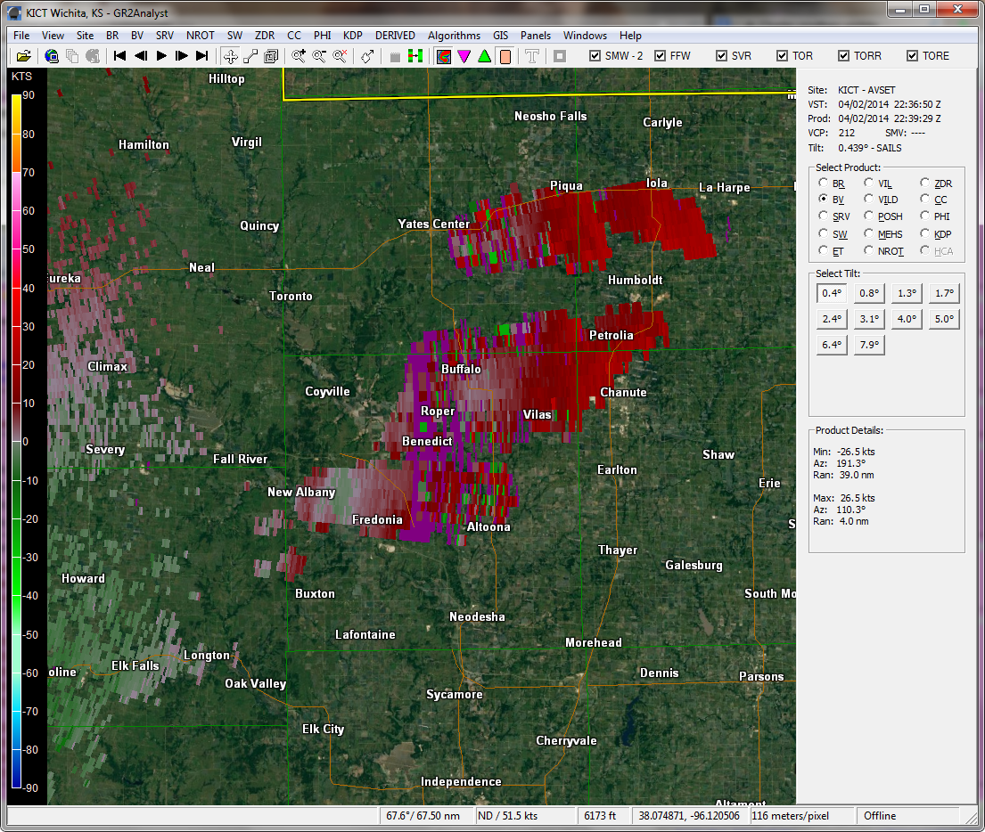
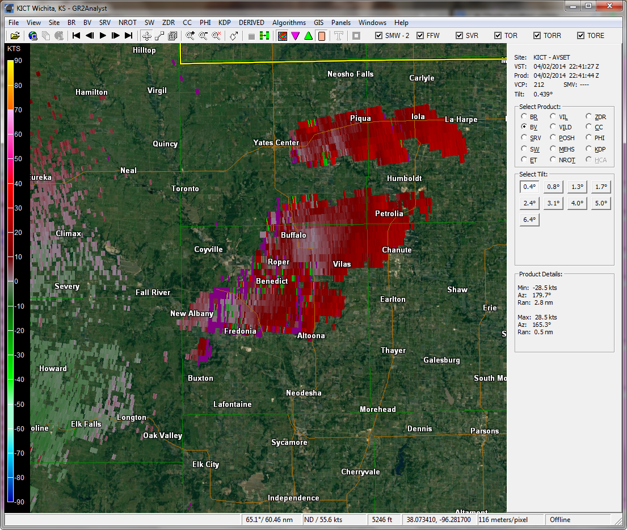
2236Z – Left
2241Z - Below

Slide 9
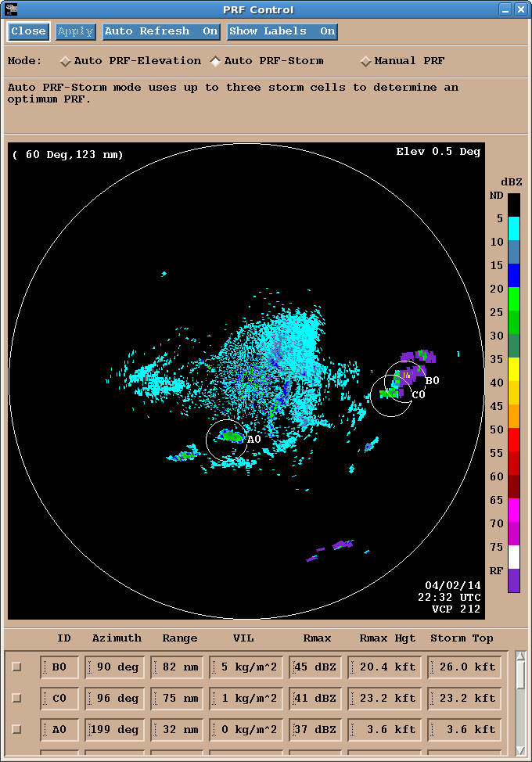
Lets Look at 22:36
The PRF for this volume scan
was determined from 22:32
All 3 Cells < 20kg/m²
(From 22:28)
Not considered by SBAP
Auto PRF-Elevation (Legacy)
Algorithm used to determine
PRF

Slide 10
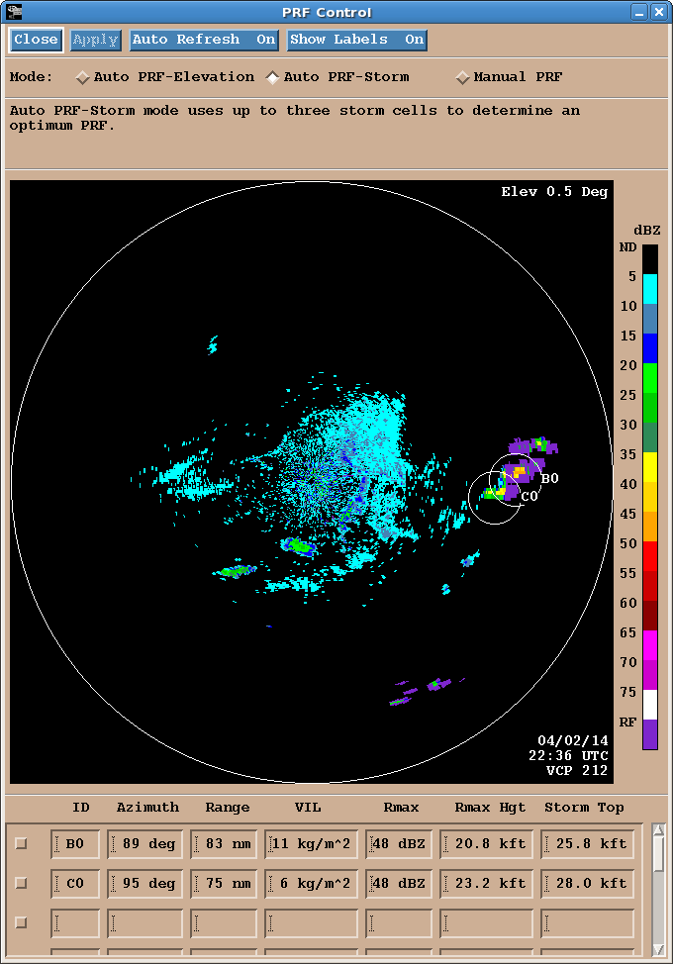
Lets Look at 22:41
The PRF for this volume scan
was determined from 22:36
Both Cells < 20kg/m²
(From 22:32)
Not considered by SBAP
Auto PRF-Elevation (Legacy)
Algorithm used to determine
PRF

Slide 11
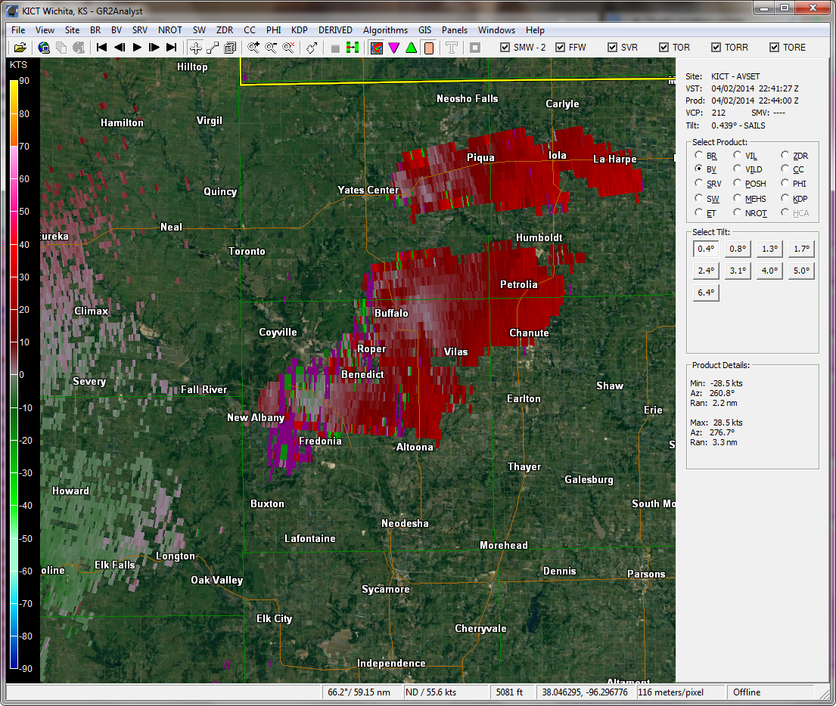
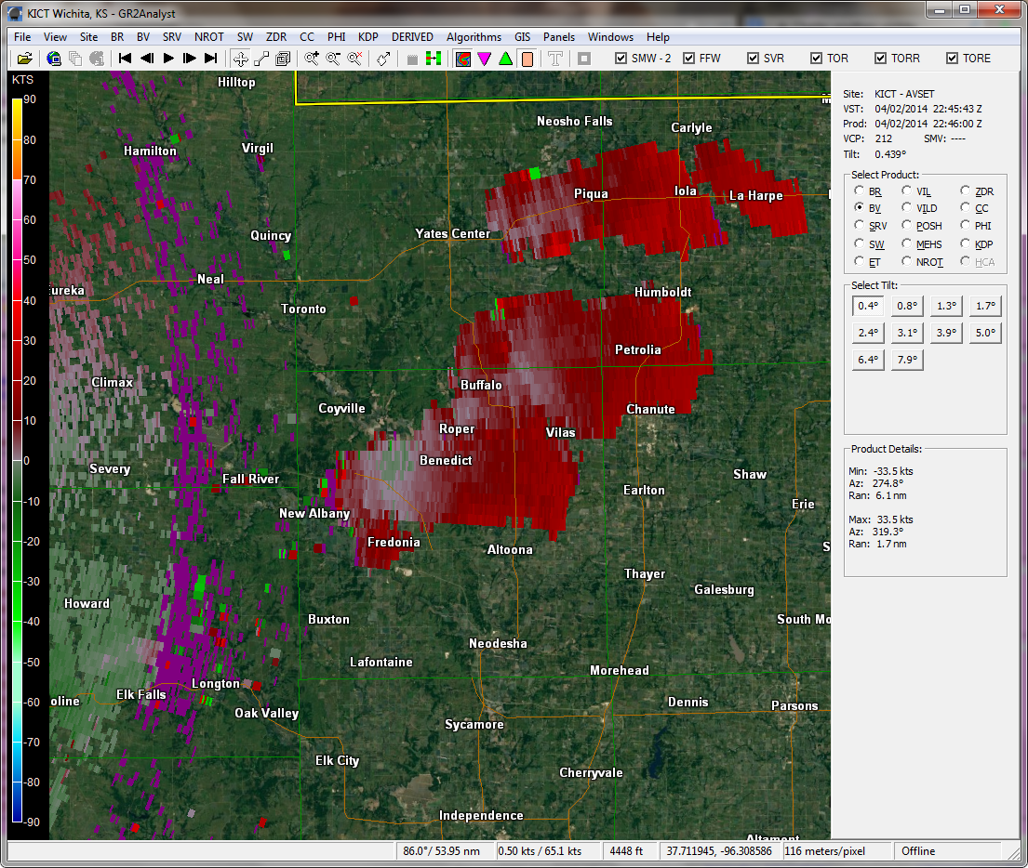
2244Z – Left (Multi-Storm)
2246Z – Below (Multi-elevation)
I can’t be 100% sure this is when we changed the PRF, but it looks like what I recall it doing when we did.

Slide 12
22:44
This product appears to be the
SAILS cut from the 22:41
Volume Scan
By design, the SAILS Doppler
cut uses the same PRF as
the base Doppler cut

Slide 13
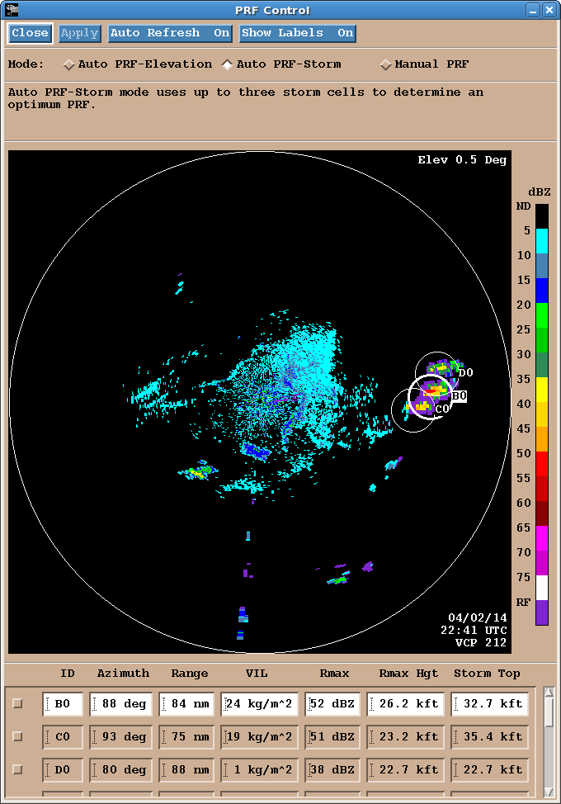
Lets Look at 22:46
The PRF for this volume scan
was determined from 22:41
1 Cell > 20kg/m²
(From 22:36)
SBAP chose PRF 8 (63nm)
(Auto PRF-Elevation would have
Selected PRF 7 for this data)

Slide 14
Summary
Storm-Based Auto PRF behaved as designed for this period
The only volume scan during this period when Storm-Based Auto PRF actually executed was 22:41
PRF 8 (63nm) was applied to 22:45
All other volume scans used Auto PRF-Elevation for PRF
During the 22:45 volume scan Auto PRF-Elevation was selected by the operator. This resulted in PRF 6 (73nm) for 22:49. NOTE: Storm-Based Auto PRF would have selected PRF 8 (63nm)

